Slide 1


Dr Shalini Sankar
23rd September 2024

Slide 2

Outline
Executive Summary
Introduction
Methodology
Results
Conclusion

Slide 3
Executive Summary
Summary of methodologies
Data collection through API
Data collection through Web Scraping
Data wrangling
Exploratory data analysis using SQL
Exploratory data analysis with data visualisation techniques
Interactive visual analytics using Folium
Building a dashboard with folium
Machine learning predictive analytics
Summary of all results
Results from exploratory data analysis
Results from interactive analysis as screenshots
Results from machine learning predictive analytics

Slide 4
Introduction
SpaceX advertises Falcon 9 rocket launches on its website, with a cost of 62 million dollars; other providers cost upward of 165 million dollars each, much of the savings is because SpaceX can reuse the first stage.
The aim of this capstone project was to predict if the Falcon 9 first stage will land successfully. By doing so, we can determine the cost of a launch.
In this capstone, I took role of a data scientist working for a new rocket company, Space Y, that would like to compete with SpaceX founded by billionaire industrialist Allon Musk. My job was to determine the price of each launch. I gathered information about Space X and created dashboards. I also determined if SpaceX could reuse the first stage. Instead of using rocket science to determine if the first stage will land successfully, I trained a machine learning model and used public information to predict if SpaceX could reuse the first stage.
Points to address:
Identifying all factors that influence whether a landing will be successful or not.
The relationships between different variables and how it affects the landing outcome.
Best conditions required to increase the likelihood of a successful landing.

Slide 5

Section 1

Slide 6
Methodology
Performed Data collection
Performed by using SpaceX API and Wikipedia Web Scraping.
Performed Data wrangling
Data was processed using one-hot encoding for categorical features. Null values were replaced with mean and unwanted columns were cleaned.
Performed exploratory data analysis (EDA) using visualization libraries and SQL
Performed interactive visual analytics using Folium and Plotly Dash
Performed predictive analysis using classification models
Building, tuning and evaluating classification models

Slide 7
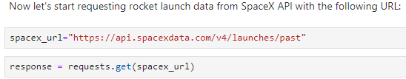
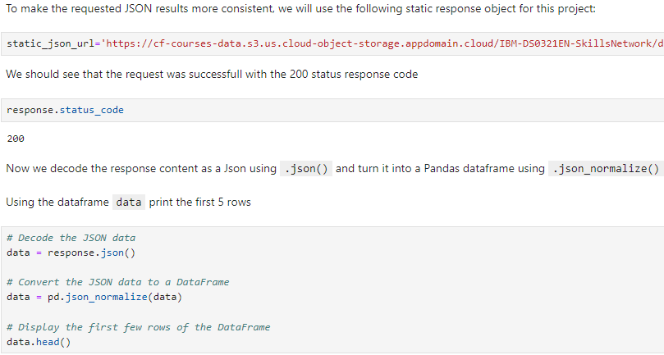
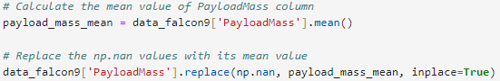
Data Collection – SpaceX API
Data collection involved gathering and measuring information on specific variables within a system, which allowed important questions to be answered and outcomes to be evaluated. The dataset was collected using a REST API and web scraping from Wikipedia.
For the REST API, a GET request was sent, and the response was decoded as JSON and converted into a pandas dataframe using json_normalize().
The data was then cleaned, missing values were replaced with mean, and any gaps were filled as needed.
Finally, the data was exported into a csv file.
GitHub URL for notebook: https://github.com/shalinimoorthy29/IBM-Data-Science-Capstone/blob/main/071_SpaceX_Data%20Collection%20API.ipynb

Slide 8
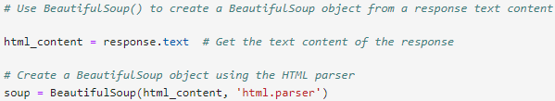
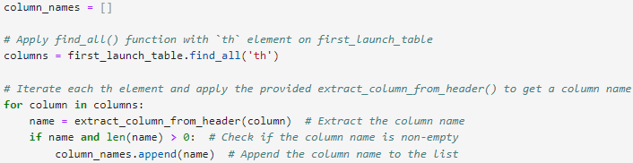
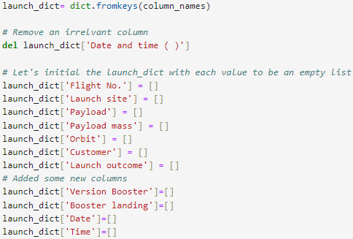
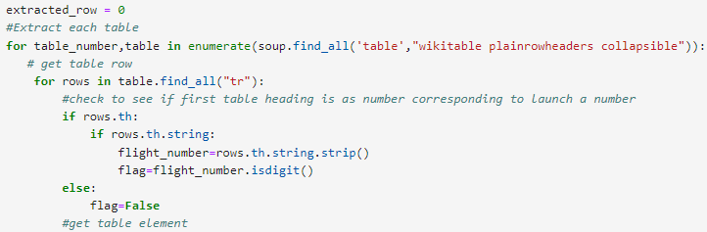
Data Collection - Scraping
Performed a HTTP GET method to request the Falcon9 Launch HTML page, as an HTTP response.
Created a BeautifulSoup object using the HTML parser
Extracted all column/variable names from the HTML table header
Created an empty dictionary with keys from the extracted column names.
This dictionary was then converted into a Pandas dataframe and data was exported to csv file.
GitHub URL for notebook: https://github.com/shalinimoorthy29/IBM-Data-Science-Capstone/blob/main/072_SpaceX_Webscraping.ipynb

Slide 9
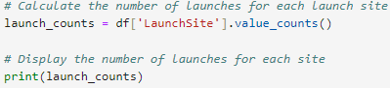
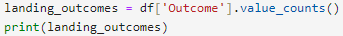
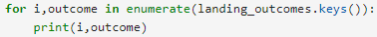
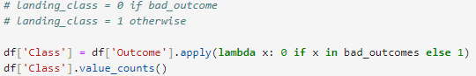
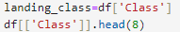
Data Wrangling
Exploratory data analysis (EDA) was performed to identify patterns in the data and determine the label for training supervised models. Firstly, the Space X dataset was loaded.
Calculated the number of launches on each site, the data frame number and occurrence of each orbit as well as the number and occurrence of mission outcome of the orbits.
Outcomes were converted into training labels, where 1 indicates the booster successfully landed and 0 means it was unsuccessful.
Data was then exported into a csv file.
GitHub URL for notebook: https://github.com/shalinimoorthy29/IBM-Data-Science-Capstone/blob/main/073_SpaceX_Data%20Wrangling.ipynb

Slide 10
EDA with Data Visualization
Scatter graphs were first used to find relationships between attributes such as:
Payload and Flight Number
Flight Number and Launch Site
Payload and Launch Site
Flight Number and Orbit Type
Payload and Orbit Type
Scatter plots help show how these attributes depend on each other. Once patterns were identified from the graphs, it became easier to see which factors had the most impact on the success of the landing outcomes.
Libraries used to perform analysis
# pandas is a software library written for the Python programming language for data manipulation and analysis.
import pandas as pd
#NumPy is a library for the Python programming language, adding support for large, multi-dimensional arrays and matrices, along with a large collection of high-level mathematical functions to operate on these arrays
import numpy as np
# Matplotlib is a plotting library for python and pyplot gives us a MATLAB like plotting framework. We will use this in our plotter function to plot data.
import matplotlib.pyplot as plt
#Seaborn is a Python data visualization library based on matplotlib. It provides a high-level interface for drawing attractive and informative statistical graphics
import seaborn as sns
GitHub URL for notebook: https://github.com/shalinimoorthy29/IBM-Data-Science-Capstone/blob/main/075_SpaceX_EDA%20with%20Visualization%20Lab.ipynb

Slide 11
EDA with SQL
Using SQL, various queries were performed to gain a better understanding of the dataset, including:
Displaying the names of the launch sites.
Displaying 5 records where launch sites begin with the string 'CCA'.
Displaying the total payload mass carried by boosters launched by NASA (CRS).
Displaying the average payload mass carried by booster version F9 v1.1.
Listing the date of the first successful landing outcome on a ground pad.
Listing the names of boosters that successfully landed on a drone ship and carried a payload mass greater than 4000 but less than 6000.
Listing the total number of successful and failed mission outcomes.
Listing the booster versions that carried the maximum payload mass.
Listing the failed drone ship landing outcomes, their booster versions, and launch site names for the year 2015.
Ranking the count of landing outcome successes between the dates 2010-06-04 and 2017-03-20 in descending order.
GitHub URL for notebook: https://github.com/shalinimoorthy29/IBM-Data-Science-Capstone/blob/main/074_SpaceX_EDA%20with%20SQL.ipynb

Slide 12
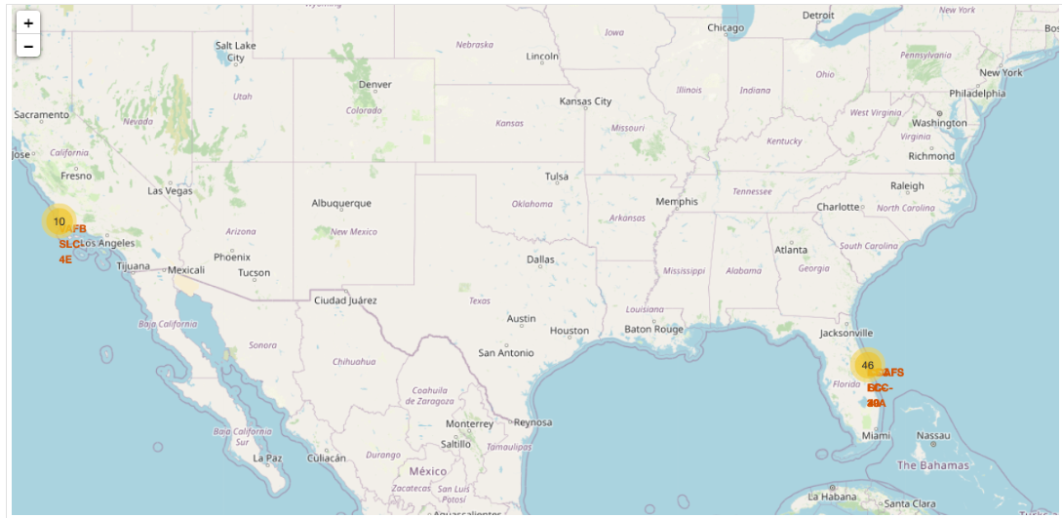
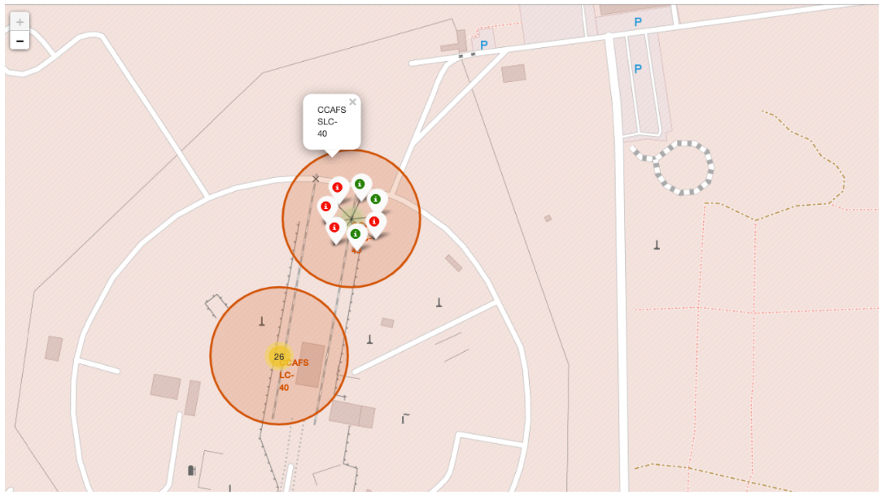
Build an Interactive Map with Folium
Interactive visual analytics were performed using Folium to explore the SpaceX launch sites:
Folium circles and markers were created and added for each launch site on the map to allow zooming in and out of the marked areas.
Successes and failed launches for each site were marked on the map.
The distances between each launch site and nearby locations were calculated.
A Mouse Position feature was added to display the coordinates (latitude and longitude) when hovering over the map.
A marker was created to show the distance to the nearest city, railway, highway, etc.
A line was drawn between the marker and the launch site to visualise the proximity.
GitHub URL for notebook: https://github.com/shalinimoorthy29/IBM-Data-Science-Capstone/blob/main/076_SpaceX_Launch%20Site%20Location%20-%20Folium.ipynb

Slide 13
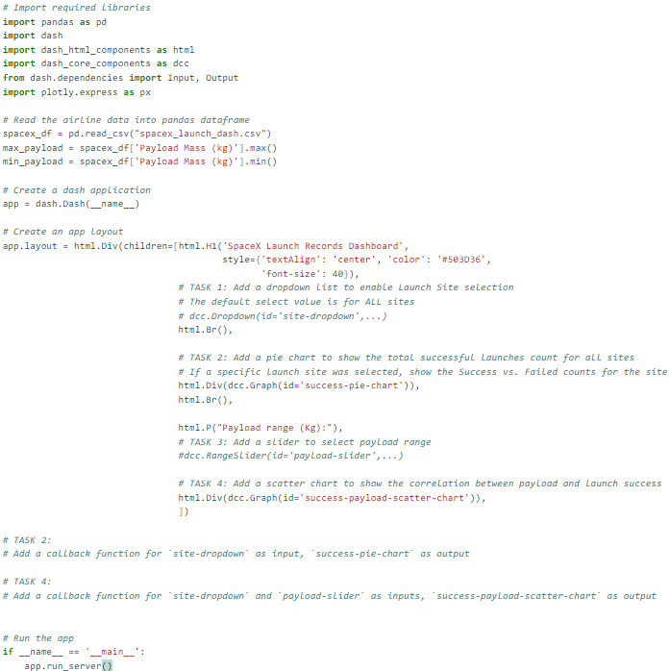
Build a Dashboard with Plotly Dash
For this part of the project, a Plotly Dash application was built for users to perform interactive visual analytics on SpaceX launch data in real-time.
Added a Launch Site Drop-down Input Component
Added a callback function to render success-pie-chart based on selected site dropdown
Added a Range Slider to Select Payload
Added a callback function to render the success-payload-scatter-chart scatter plot
GitHub URL for notebook: https://github.com/shalinimoorthy29/IBM-Data-Science-Capstone/blob/main/spacex_dash_app.py

Slide 14
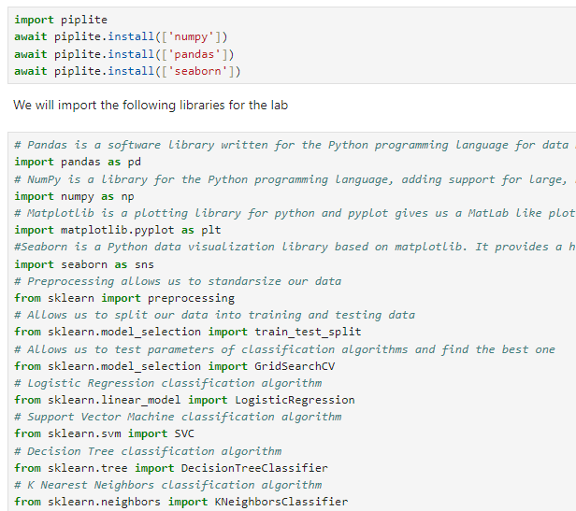
Predictive Analysis (Classification)
The data was loaded using numpy and pandas, then transformed and split into training and testing sets.
Different machine learning models were built.
Hyperparameters were tuned using GridSearchCV.
Accuracy was used as the evaluation metric for the models.
The model was further improved through feature engineering and algorithm tuning.
The best-performing classification model was identified after testing and tuning (K-Nearest Neighbors , DecisionTree, LogisticRegression, Support Vector Machine).
Libraries used to perform analysis
GitHub URL for notebook: https://github.com/shalinimoorthy29/IBM-Data-Science-Capstone/blob/main/077_SpaceX_Machine%20Learning%20Prediction.ipynb

Slide 15
Results
Results from data analysis with visualization libraries
Results from data analysis with SQL
Screenshots from interactive data analysis with Folium
Screenshots from dashboard using Plotly dash
Results from predictive analysis

Slide 16

Section 2

Slide 17
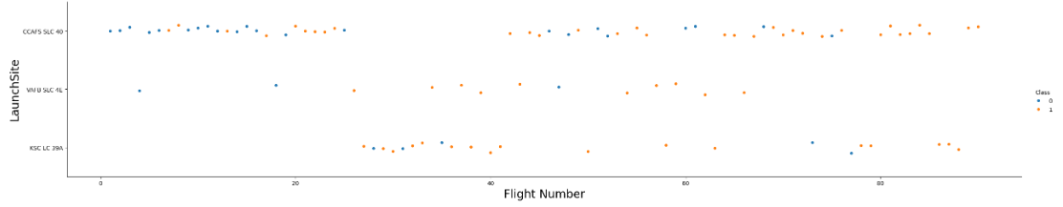
Flight Number vs. Launch Site
Launches from the site CCAFS SLC 40 are much higher than the other two sites

Slide 18
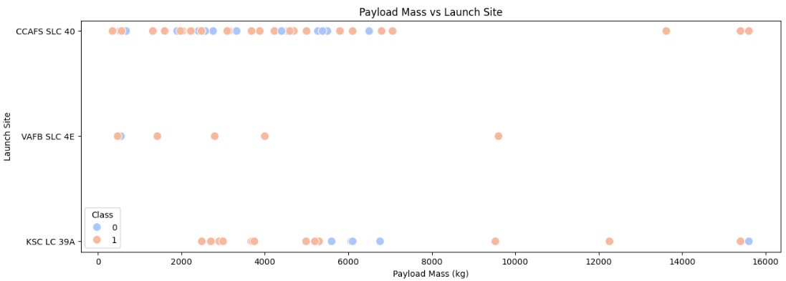
Payload vs. Launch Site
Majority of flights with payload mass less than 10000kg have been launched from site CCAFS SLC 40.
At the VAFB-SLC launch site there are no flights launched for heavy payload mass (greater than 10000).

Slide 19
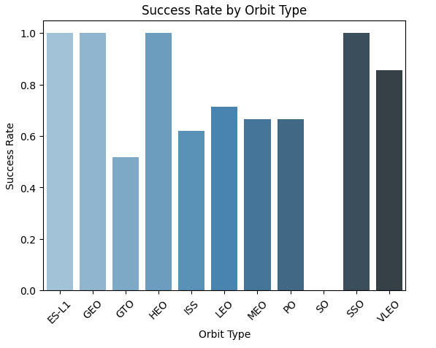
Success Rate vs. Orbit Type
The best success rates are for orbit types ES-L1, GEO, HEO and SSO

Slide 20
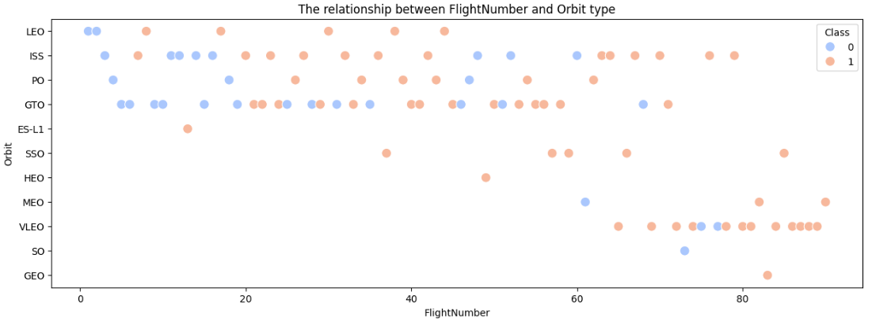
Flight Number vs. Orbit Type
It can be observed that in the Low Earth Orbit (LEO), the success of a mission seems to correlate with the number of flights. However, in the Geostationary Transfer Orbit (GTO), there appears to be no clear relationship between the flight number and the success of the mission.

Slide 21
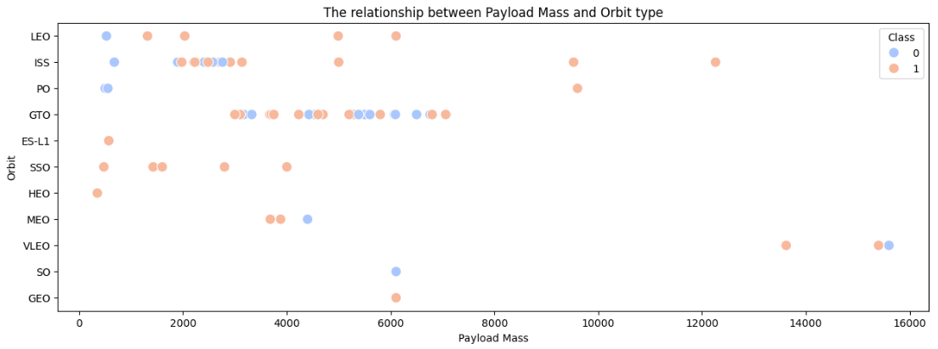
Payload vs. Orbit Type
With heavy payloads, the successful landing rate tends to be higher for missions to Polar, Low Earth Orbit (LEO), and the International Space Station (ISS). However, for Geostationary Transfer Orbit (GTO), it is harder to differentiate between successful and unsuccessful landings, as both outcomes are frequently observed.

Slide 22
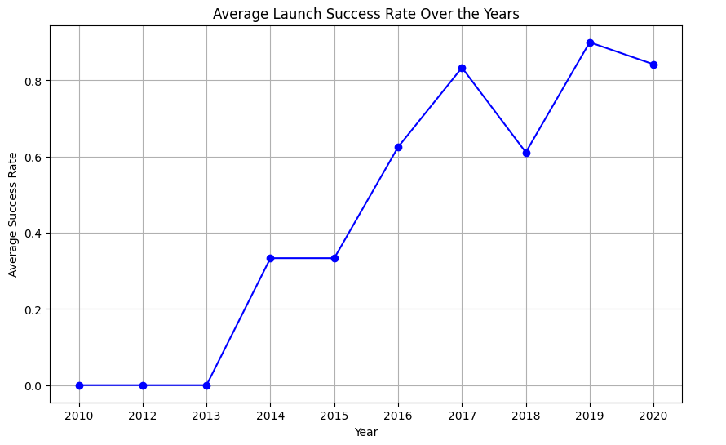
Launch Success Yearly Trend
The success rate of launches has steadily increased since 2013, continuing to rise through to 2020. This suggests ongoing improvements in technology and operational efficiency over this period.

Slide 23
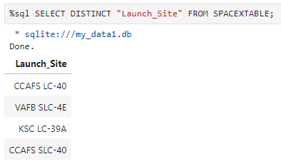
All Launch Site Names
This SQL query retrieves all the unique launch sites from the **SPACEXTABLE** by selecting distinct values from the "Launch_Site" column. It eliminates duplicates to provide a list of unique launch locations.

Slide 24
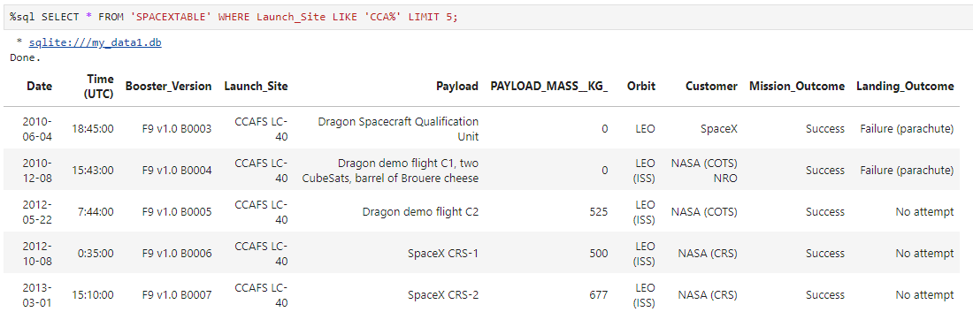
Launch Site Names Begin with 'CCA'
This SQL query retrieves all columns (`*`) from the **SPACEXTABLE** where the launch site name starts with 'CCA'. The `LIKE 'CCA%'` condition filters records for launch sites whose names begin with 'CCA', and the query is limited to return only the first five results.

Slide 25
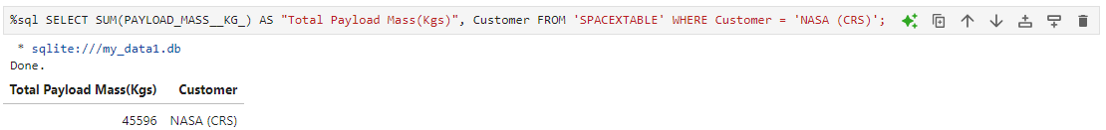
Total Payload Mass
This query calculates the total payload mass (in kilograms) launched by NASA under the CRS (Commercial Resupply Services) program. It sums up the `PAYLOAD_MASS__KG_` for all records where the `Customer` is 'NASA (CRS)', displaying the total payload mass along with the customer name.

Slide 26
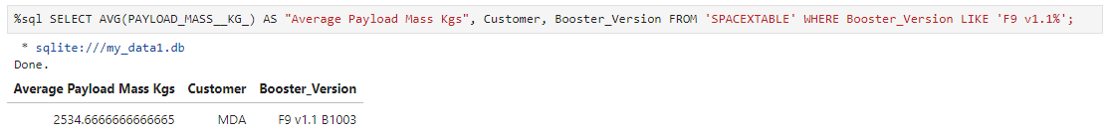
Average Payload Mass by F9 v1.1
This query computes the average payload mass (in kilograms) for launches using the 'F9 v1.1' booster version. It filters the results to include only records where the `Booster_Version` begins with 'F9 v1.1%', and returns the average payload mass, along with the corresponding customer and booster version.

Slide 27
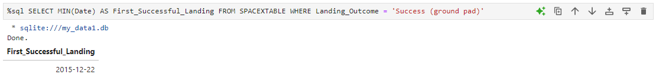
First Successful Ground Landing Date
This query retrieves the earliest date (`MIN(Date)`) when a successful landing occurred on a ground pad. It filters the records to include only those where the `Landing_Outcome` is 'Success (ground pad)', identifying the first successful ground landing in the dataset.

Slide 28
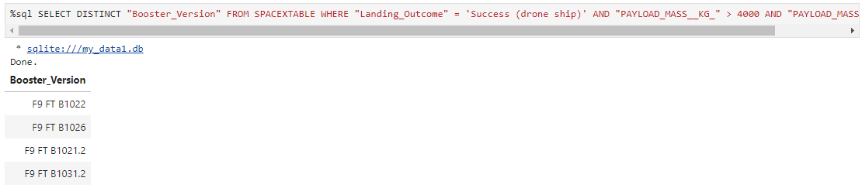
Successful Drone Ship Landing with Payload between 4000 and 6000
This query retrieves the distinct booster versions that successfully landed on a drone ship, with a payload mass between 4000 kg and 6000 kg. It filters the results to only include rows where the `Landing_Outcome` is 'Success (drone ship)' and the `PAYLOAD_MASS__KG_` falls within the specified range.

Slide 29
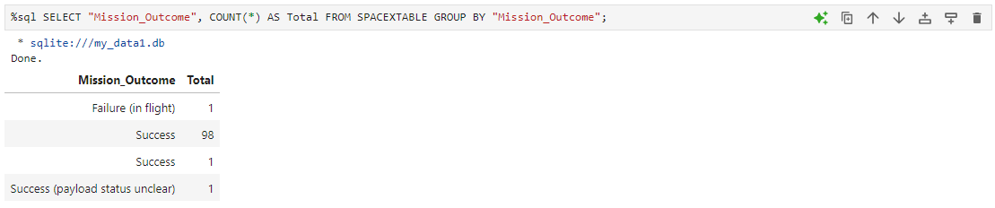
Total Number of Successful and Failure Mission Outcomes
This query groups the data by the `Mission_Outcome` column and counts how many times each unique outcome occurs. The result shows the total number of missions for each possible mission outcome in the `SPACEXTABLE`.

Slide 30
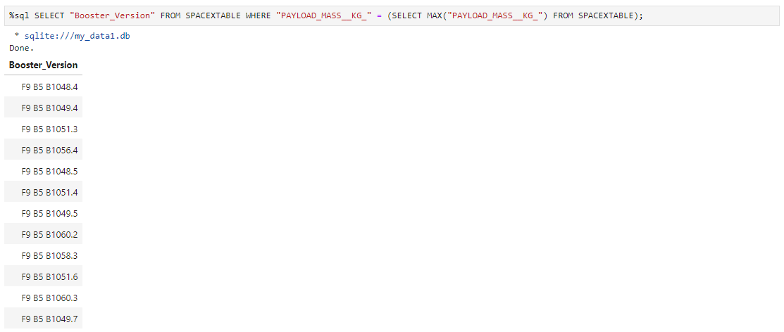
Boosters Carried Maximum Payload
This query retrieves the `Booster_Version` associated with the maximum payload mass recorded in the `SPACEXTABLE`. It uses a subquery to first find the highest payload mass and then selects the corresponding booster version that achieved this maximum payload.

Slide 31
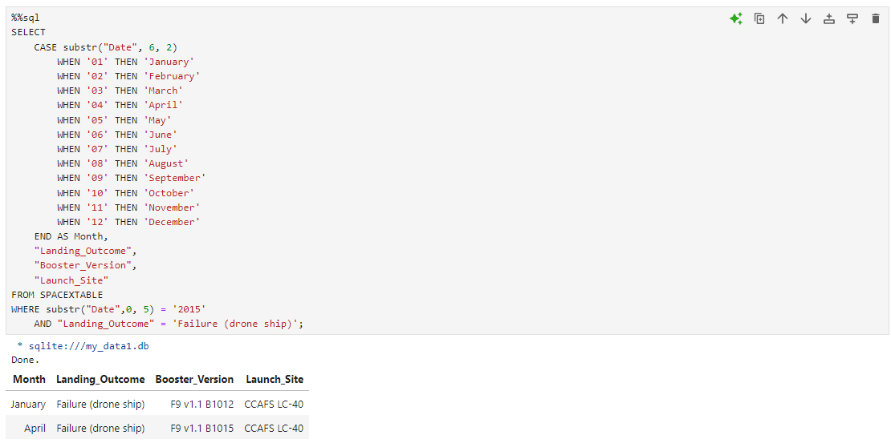
2015 Launch Records
This query extracts the month, landing outcome, booster version, and launch site from the `SPACEXTABLE` for records in the year 2015 where the landing outcome was a failure on a drone ship. The `CASE` statement converts the month number (extracted from the "Date" column) into its corresponding name, allowing for clearer interpretation of the results.

Slide 32
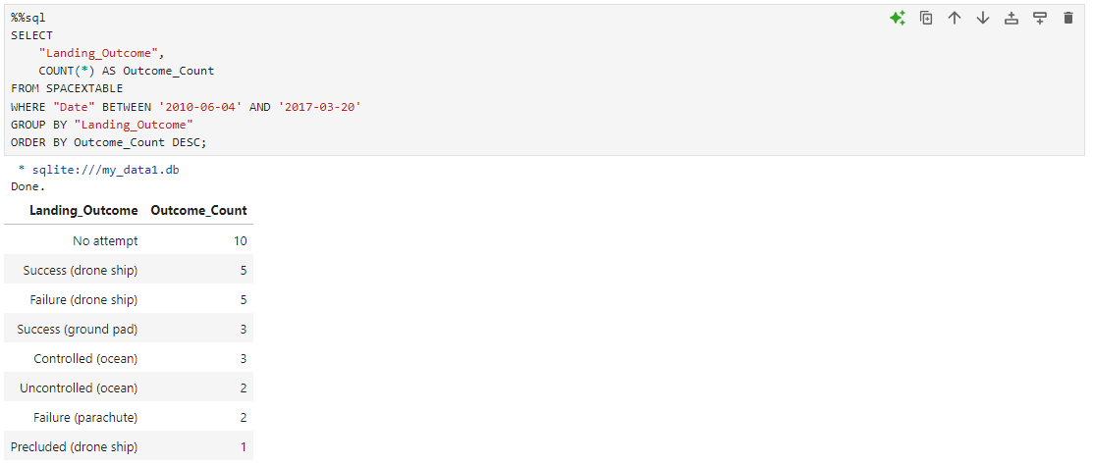
Rank Landing Outcomes Between 2010-06-04 and 2017-03-20
This query counts the number of launches categorized by their landing outcomes from the `SPACEXTABLE` between the specified dates (June 4, 2010, to March 20, 2017). The results are grouped by landing outcome, and the `ORDER BY` clause sorts the outcomes in descending order of their counts, allowing for quick identification of the most common landing outcomes within that date range.

Slide 33

Section 3

Slide 34
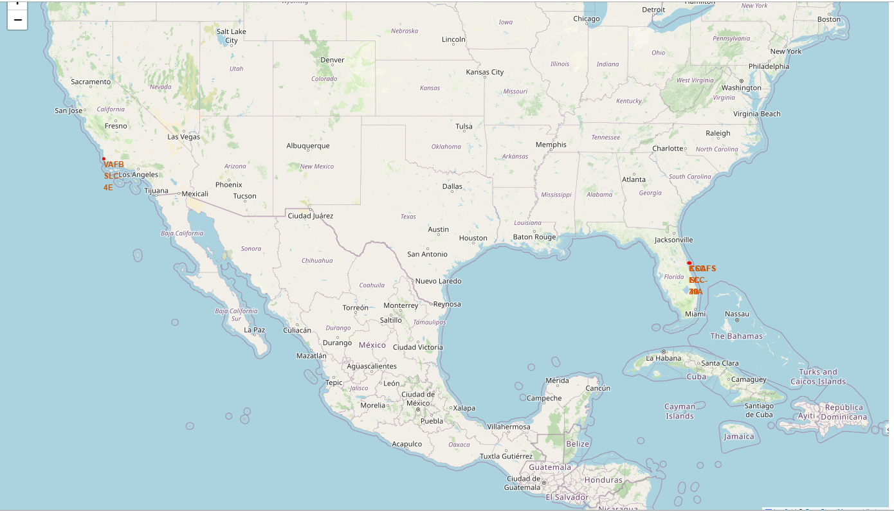
Marking of all launch sites

Slide 35

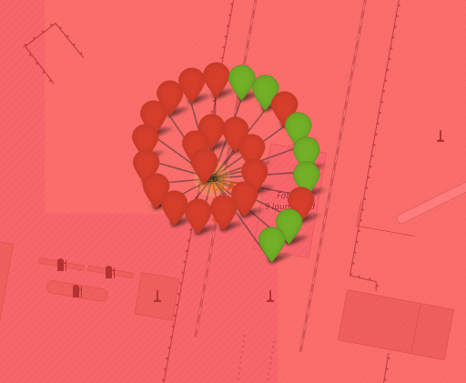

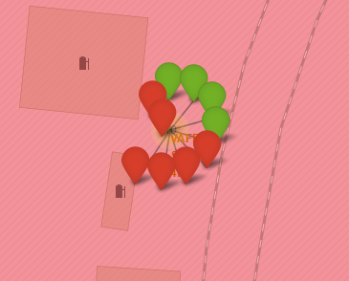
Coloured markings on launch outcomes at various sites
KSC LC-39A
CCAFS LC-40
CCAFS SLC-40
VAFB SLC-4E
Green = Successful
Red = Failed

Slide 36
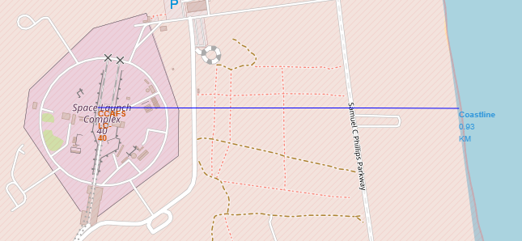
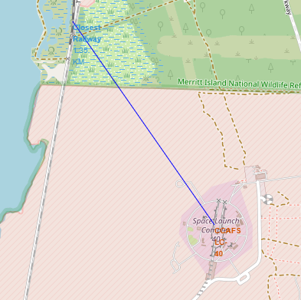
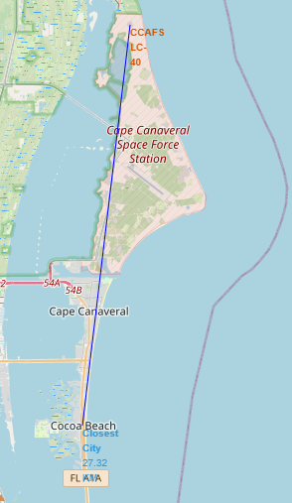
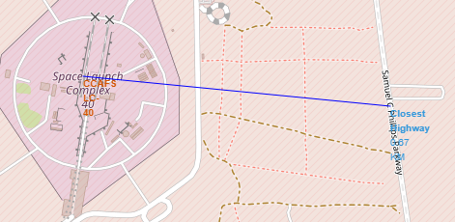
Distance from selected launch site to closest coastline, railroad, city and highway
Proximity to coastline
Proximity to railroad
Proximity to city
Proximity to highway
Launch site is not particularly close to railroads, highways or cities. This could be due to safety reasons.
Launch site is closer to coastline compared to the other landmarks.

Slide 37

Section 4

Slide 38
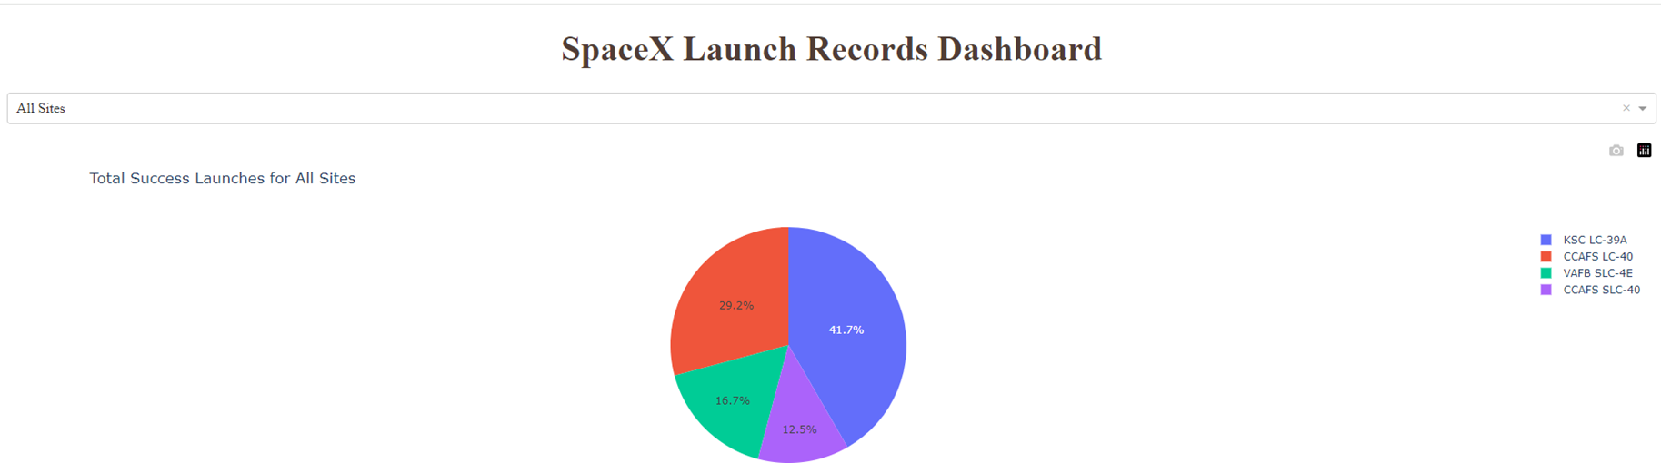
Launch success count
KSC LC -39A has had the most successful launches

Slide 39
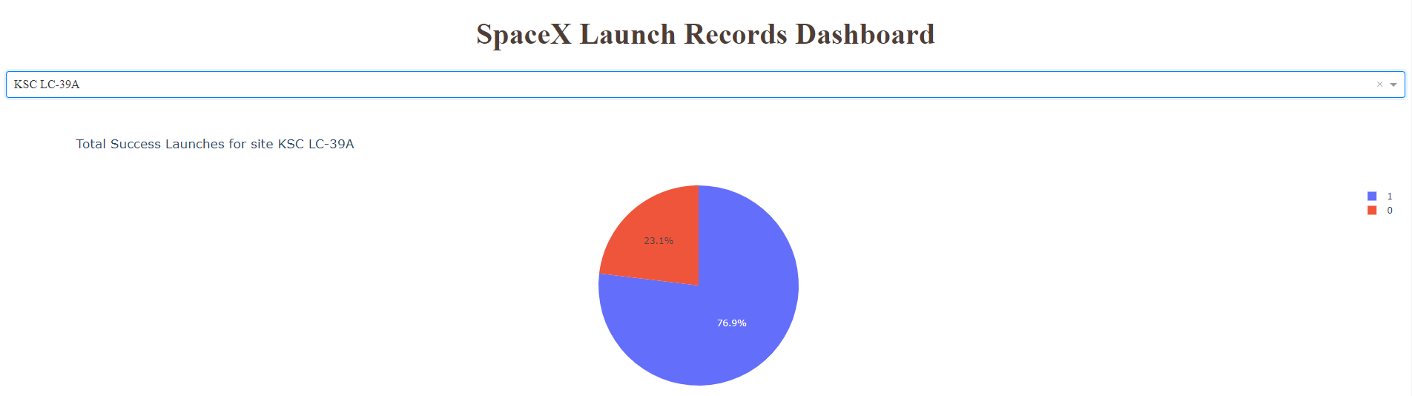
Launch site with the highest launch success ratio
KSC LC -39A has had highest launch success ratio

Slide 40
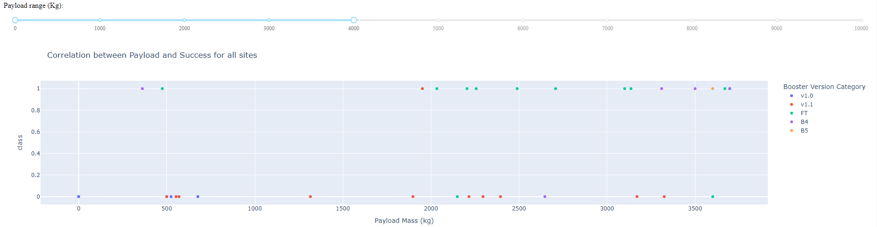
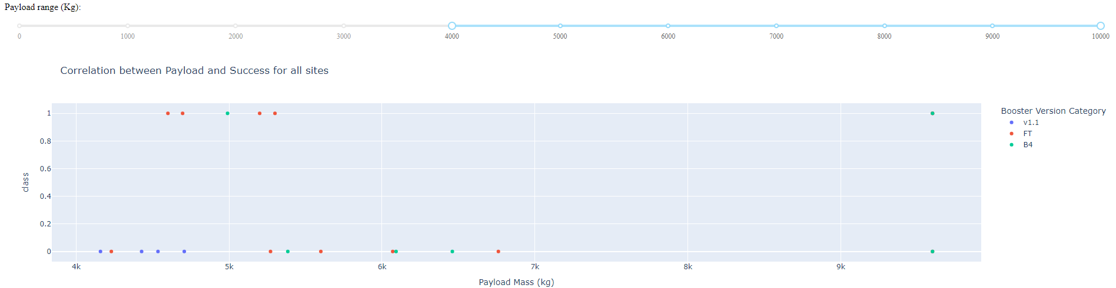
Payload vs Launch Outcome for all sites, with different payload selected in the range slider
0 – 4000kg
Success rate is better overall for lower payload mass range compared to the higher range.
0 – 10000kg

Slide 41
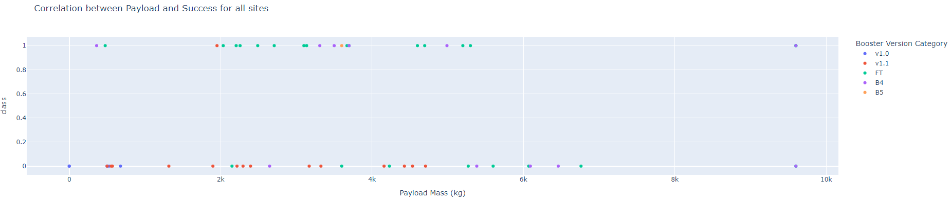
F9 Booster version and launch success rate
The FT booster version has the highest launch success rate

Slide 42

Section 5

Slide 43
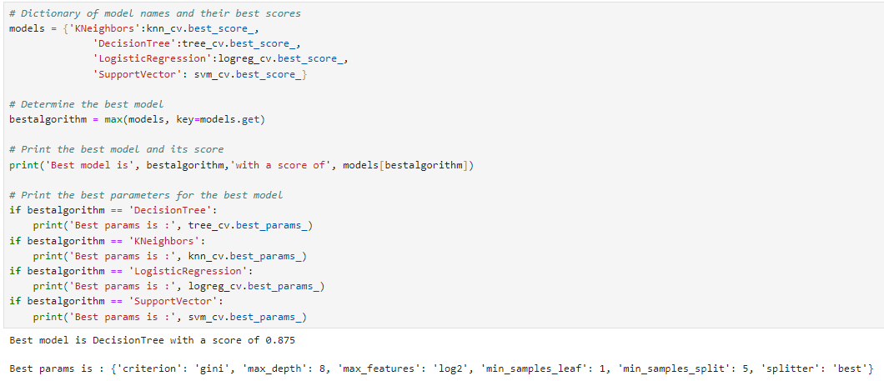
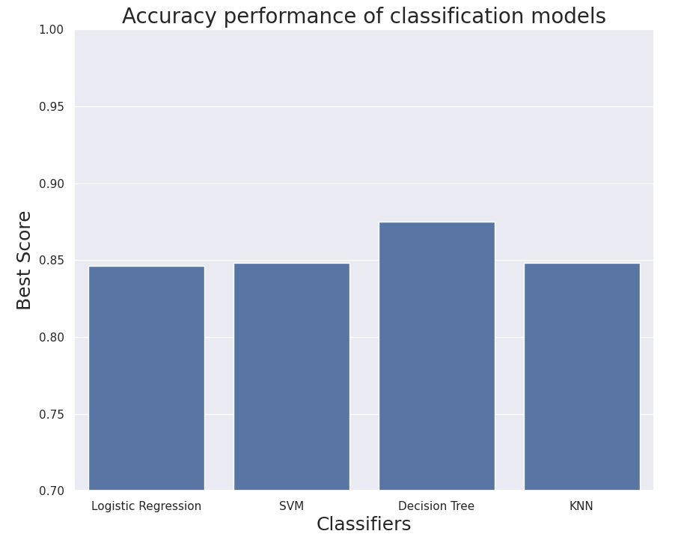
Classification Accuracy
DecisionTree model performs the best with a score of 0.875

Slide 44
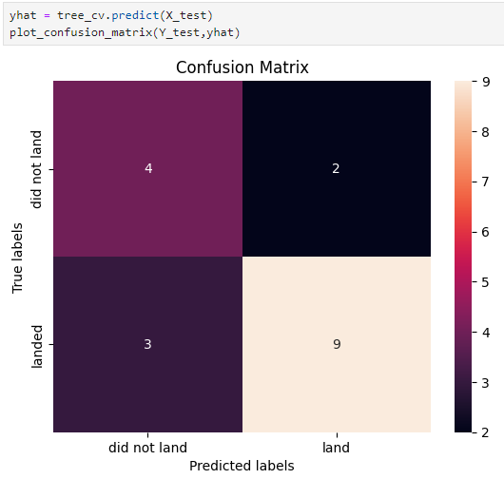
Confusion Matrix
DecisionTree
The confusion matrix provides insights into the performance of your classification model, which predicts whether a Falcon 9 booster landed or did not land.
True Negatives (Top-Left, 4): The model correctly predicted 4 instances where the booster did not land.
False Positives (Top-Right, 2): The model incorrectly predicted that 2 boosters landed, but they did not.
False Negatives (Bottom-Left, 3): The model incorrectly predicted that 3 boosters did not land, but they actually did.
True Positives (Bottom-Right, 9): The model correctly predicted 9 instances where the booster landed.
This confusion matrix shows that your model is performing reasonably well but tends to misclassify a few landings and non-landings. If the main goal is to maximize the prediction of successful landings, focusing on improving recall could help reduce the number of false negatives.

Slide 45
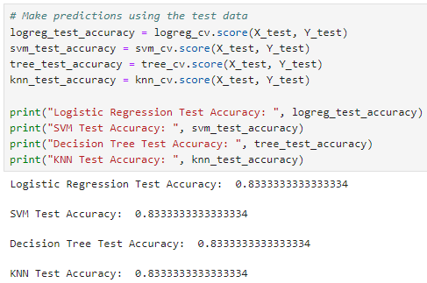
Accuracy of test data

Slide 46
Conclusions
Flight Amount and Success Rate – A positive correlation was identified between the number of launches at a site and the success rate, which suggests operational experience may contribute to better outcomes.
Launch Success Rate Over Time - The trend from 2013 to 2020 shows an increase in success rate, likely due to technological improvements, experience, and operational refinements over the years.
Successful Orbits - Specific orbits like ES-L1, GEO, HEO, SSO, and VLEO seem to have a higher success rate, possibly due to the familiarity with these missions and refined launch procedures for those orbits.
Most Successful Launch Site - KSC LC-39A being the most successful site is an important operational insight, as it indicates that this site is optimal for launches, possibly due to infrastructure, location, or other factors.
Best Machine Learning Algorithm - After evaluating the different classifiers, it appears the Decision Tree classifier performed the best, suggesting that it is well-suited for predicting launch success based on the available features.
These conclusions can be used to guide further exploration of launch site optimization, orbital success factors, and future machine learning tasks with a focus on improving predictive accuracy.

Slide 47


